Slide 1


Expert Hacks:
Cracking the Data Science Interview
Anish Mahapatra | 04 April, 2022

Slide 2

Agenda
01
Introduction
02
Why choose Data Science?
03
Roles in Data Science
04
Move into Data Science
05
Strategies to transition (mind-maps)
06
Expert Hacks
Notes:
Expertrons Company Profile: Valuation & Investors | PitchBook

Slide 3











Topic 1 of 6
Introduction
Senior Data Scientist
LinkedIn: www.linkedin.com/in/anishmahapatra Medium: anishmahapatra.medium.com Website: www.anishmahapatra.com
GitHub: www.github.com/anishmahapatra
Q. How to get into Data Science?
A. Simple, ask a real-world Data Scientist.

Slide 4




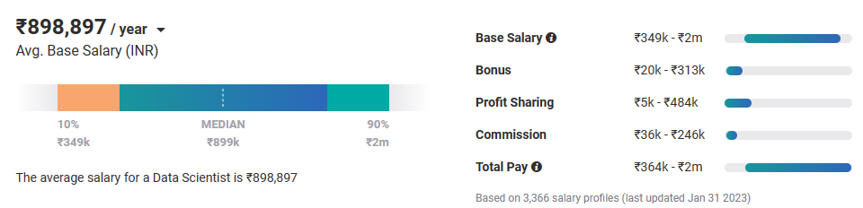
Topic 2 of 6
Why choose Data Science?
01
02
03
Relevance in the future
Business & Technology
Industry-Agnostic
Companies are building and growing in Data and it is the future.
Data Science is a combination of Business, Math and Technology, so growth can be in business / technology
Use your existing knowledge / domain / technology expertise with a data-edge
04
Extremely High Market Demand
Supply-Demand mismatch means companies are willing to pay more
Notes:
Source:https://www.payscale.com/research/IN/Job=Data_Scientist/Salary

Slide 5



Topic 3 of 6
Roles in Data Science
01
02
03
Data Engineer
Machine Learning Engineer
Business Analyst
Data Movement, Building Data pipelines, Quality of Data, Data Governance
Experimentation to get output, Modelling, Making the most out of data, Data Analytics
Client communication & management, Dashboarding & Reporting, Visualization, Decision Making
04
Data Scientist
Data on the cloud, modelling in all capacities, visualization, presentation to stakeholders, team management
Notes:
Source: https://databricks.com/blog/2020/08/03/modern-industrial-iot-analytics-on-azure-part-1.html

Slide 6












Topic 3 of 6
Tools & Technologies in Data Science
Data Engineer
Machine Learning Engineer
Business Analyst
Data Scientist

Slide 7
Topic 4 of 6
How to move into Data Science
01
02
03
Set Target
Optimize your resume
Build LinkedIn Profile
Decide the kind of roles to target, Talk to people who are doing what you want to do
Understand how ATS works (keywords),
Put keywords in your resume (SEO), Take feedback on resume
Add certifications, Get recommendations Participate in competitions, Do projects,
Keyword Optimization / SEO
06
05
04
Globally Accepted Degree (70%)
Build Relevant Network
Have high standards
Start writing about Data Science, Connect with recruiters, Build a strong base,
Be active on LinkedIn, Medium
Have real interest, Google & know about the latest happenings
You need to know what you are looking for.
Money, growth, industry change, career trajectory, culture
Globally recognized degree, Degree Accepted by MNCs,
Possibility of PhD later,
Alumni Status
Bonus - WES Certification, Teachers from the industry
Notes:
LinkedIn: https://www.linkedin.com/in/anishmahapatra/
Word Cloud: https://monkeylearn.com/word-cloud/
Naukri: https://www.naukri.com/mnjuser/homepage

Slide 8




Topic 3 of 6
Roles in Data Science
01
02
03
Fresher
Experienced in
Another Domain
Move to
Data Science
04
Grow as a
Data Scientist
Notes:
Source: https://databricks.com/blog/2020/08/03/modern-industrial-iot-analytics-on-azure-part-1.html

Slide 9
A glance into your journey once you enroll with a Data Science & MAchine Learning course
Features Offered
Duration
Program Phase
6 months - ∞
Alumni Phase
Access to job portal
High Performance Coaching
In this phase, the learners has access to course content for 3 years. Frequent online meetups and sessions on trending topics in the field of Data Science are conducted for all alumnus of upGrad
3-6 months
Career Phase (3-6 months after program completion)
Personalised career mentor
LinkendIn Profile and Resume Builder
1:1 Mock Interviews (on request)
In this phase, every learner is assigned a career coach to provide to personalised guidance and action plan to achieve the desired outcomes. Mock-interviews can be scheduled on request basis in a very short time.
Access to job portal
High Performance Coaching
9-12 months
In-program Phase
Every week the learner learns a new concept, practices the concept, and clears graded questions at the time of his/her convenience (through recorded videos and upGrad platform). Exams are conducted twice in the entire program to test the learnings and help learners revise the concepts learnt The learner gets access to job portal and can start applying to the roles of interest. The curriculum is designed in a manner to help gain both hard skills and soft skills to crack the interviews.
Access to learning platform
Live Sessions with top experts
Daily Doubt Resolution
Personalised Industry Mentorship
Access to Job portal
Soft Skills module
Interview Prep
1:1 Mock Interviews (on request)
Pre-Launch Preparatory Phase
0-90 days
Once the learner clears entrance test and enrolls into the program, the learner has access to preparatory content to help revise the important concepts and come into the zone of studying and learning
Access to learning platform

Slide 10
Learner Journey
A personalised learning journey to deliver target outcomes to learners.
Features:
Lifelong Learning
Career Support
Peer Networking
Features:
Learning: Online + Live
Support
Academic
Non Academic
Career
Career Centre
Placement Support
1:1 Mentorship
Just in Time Mock Interview
Alumni
_{Career Phase}
Features:
High Performance Coaching
Career Features
Career Webinar
Just in Time Mock Interview
Career Centre
Placement Support
Program Phase
Pre - Program Phase
Features:
Onboarding Call
Prep Content
Program Calendar
Student Manual
Welcome Webinar

Slide 11





Topic 4 of 6
Resume Optimization (Demo)

Slide 12
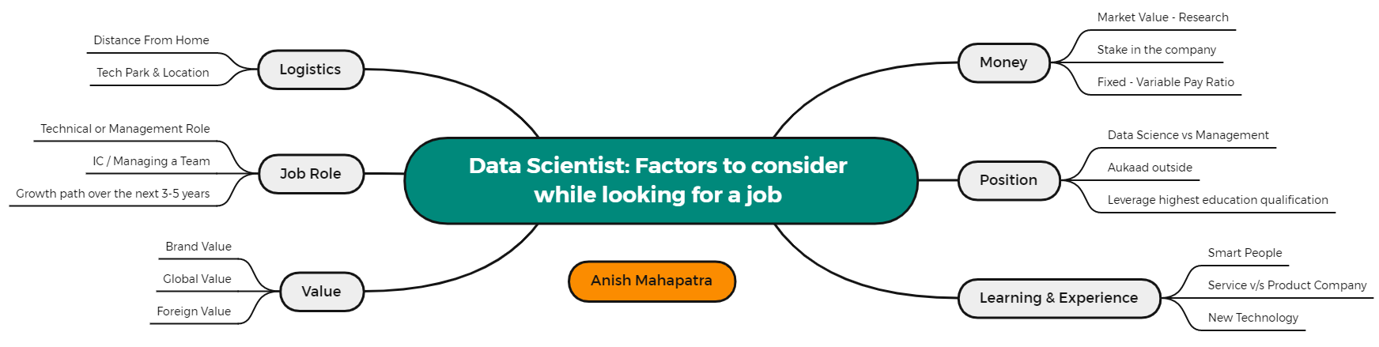
Topic 5 of 6
Factors to consider while looking for a job

Slide 13
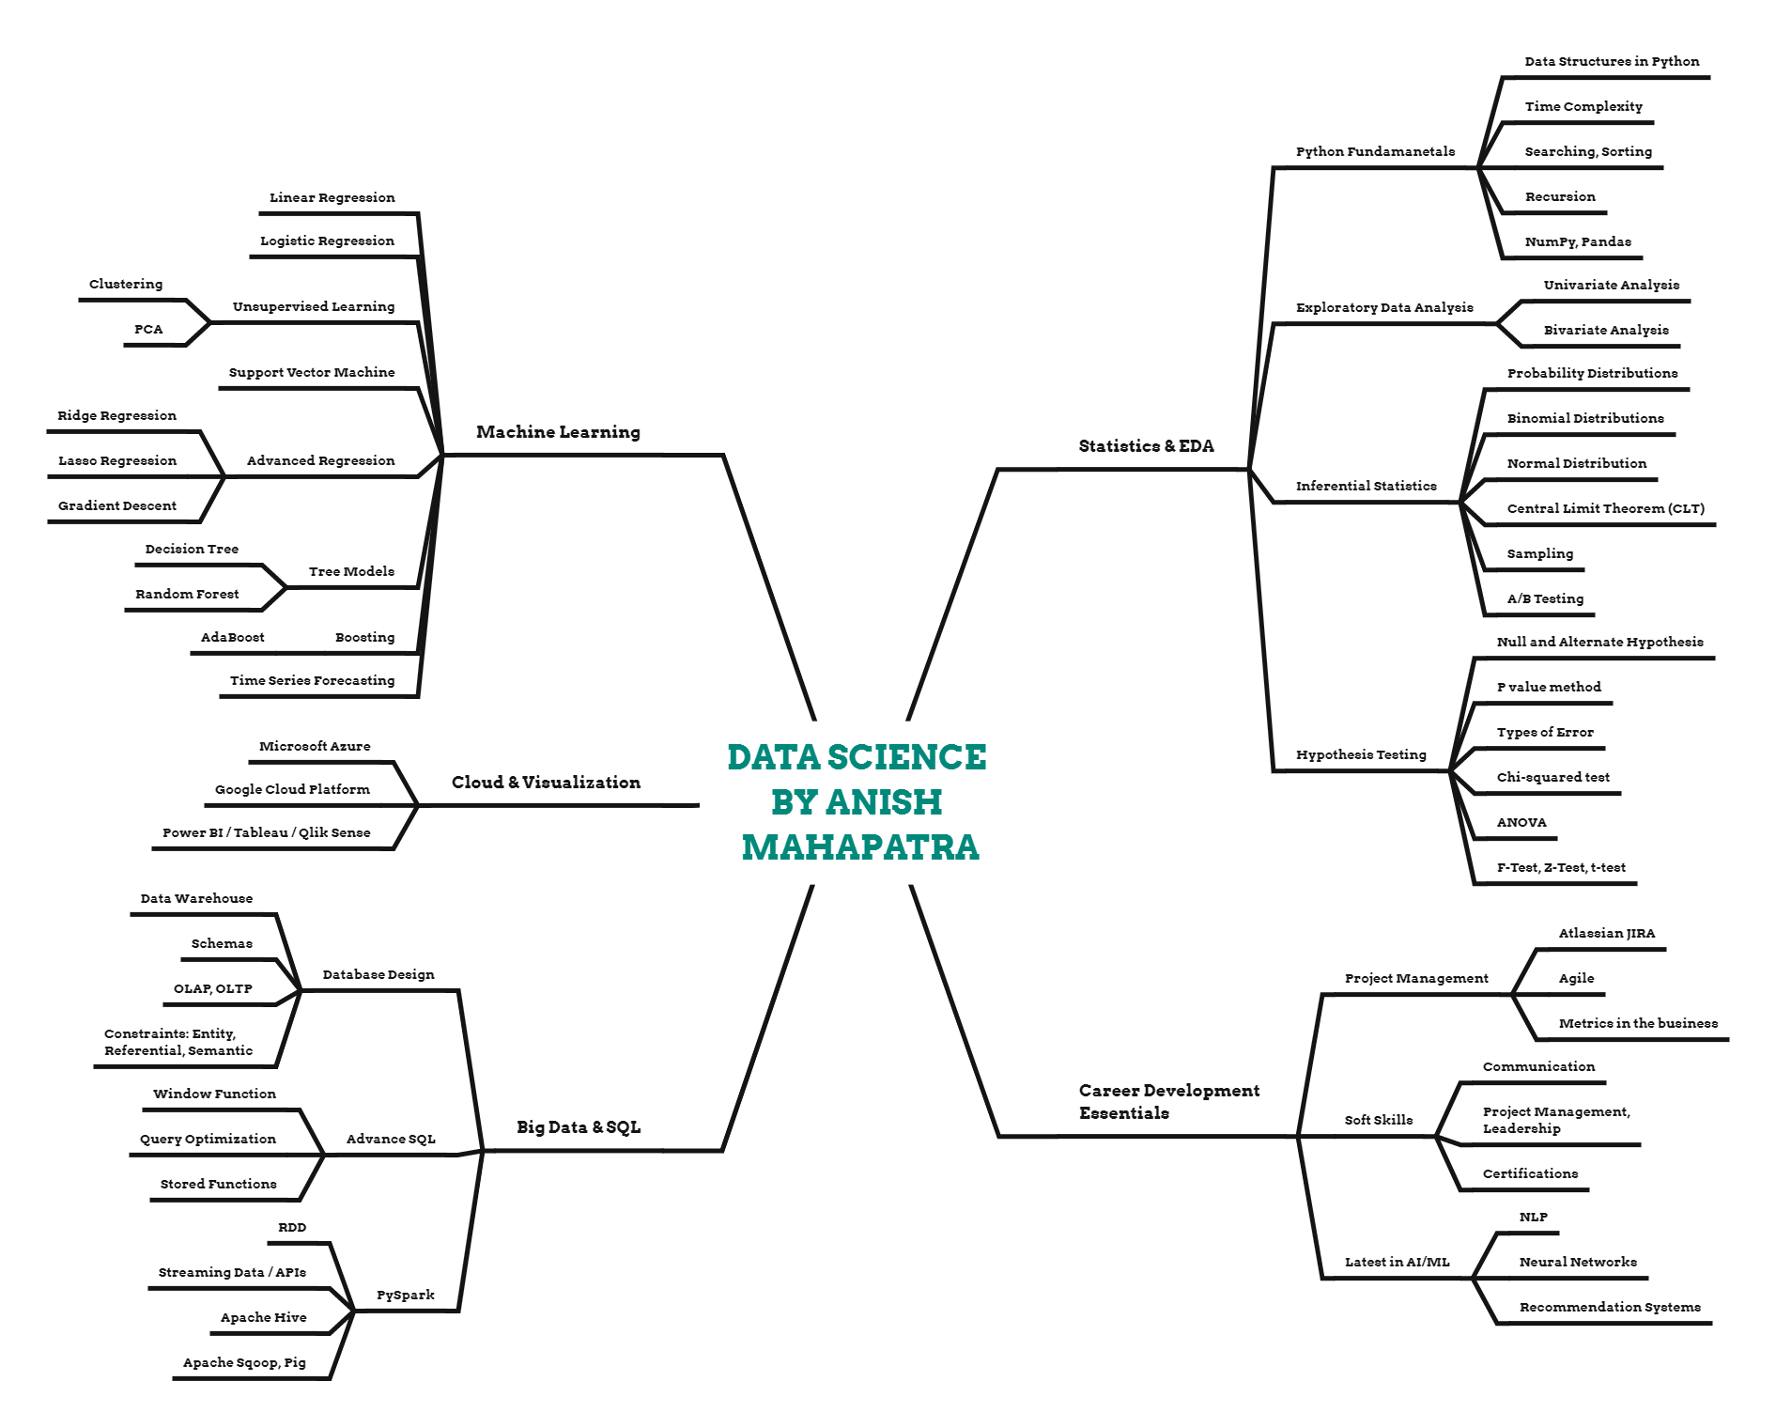
Topic 5 of 6
Plan your Data Science prep

Slide 14
Expert Hacks
01
Have Templates on Notion
02
Send Thank you Email after Interview
03
Have an Interview Tracker
04
Google Top 100 Interview Questions for Data Science, ML, SQL, Python
05
Have a Master’s Degree
06
Be Active & Proactive in replying
Notes:
Expertrons Company Profile: Valuation & Investors | PitchBook

Slide 15
Key Takeaways
01
Introduction - Anish Mahapatra
02
Why choose Data Science? - Highest ROI
03
Roles in Data Science - DE, MLE, BA, DS
04
Move into Data Science - Step-by-Step, Global Degree
05
Strategies to transition (mind-maps)
06
Expert Hacks - Pro-tips
Notes:
Expertrons Company Profile: Valuation & Investors | PitchBook

Slide 16

Expert Hacks:
Cracking the Data Science Interview
Anish Mahapatra
Q&A Session
LinkedIn: www.linkedin.com/in/anishmahapatra
Email: anishmahapatra01@gmail.com

Slide 17
Expert Hacks:
Cracking the Data Science Interview
Anish Mahapatra | 04 April, 2022
Thank you.

